Slide 1
TEAL2.O: Getting started
Improving Access to Science and Technology Higher Education in Resource-Poor Institutions through an Open Platform for Technology Enabled Active Learning Environment / TEAL2.O
Ref. no. 610186-EPP-1-2019-LK -EPPKA2-CBHE-JP
The European Commission's support for the production of this publication does not constitute an endorsement of the contents, which reflect the views only of the authors, and the Commission cannot be held responsible for any use which may be made of the information contained therein.

Slide 2
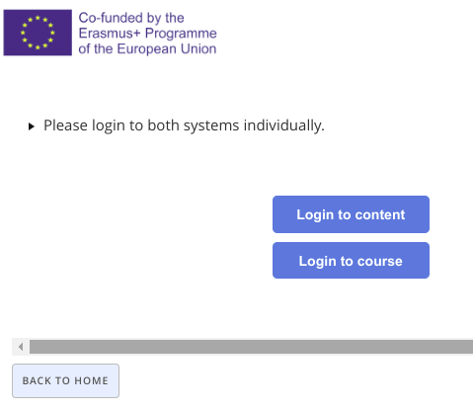
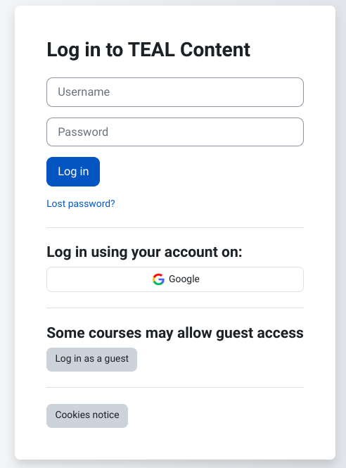
Login process
1
2
3
Application URL
https://teal2o.pdn.ac.lk/teal-lrm/

Slide 3
Create/Update/Fork content
Update content version
Program/Course creation/edit tool and Classroom creation

Slide 4
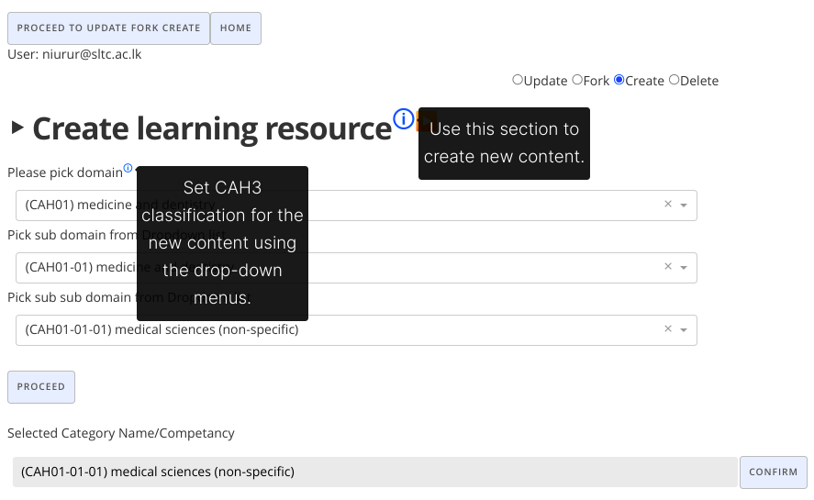
Notes:
UTBv, RKU, VIT

Slide 5
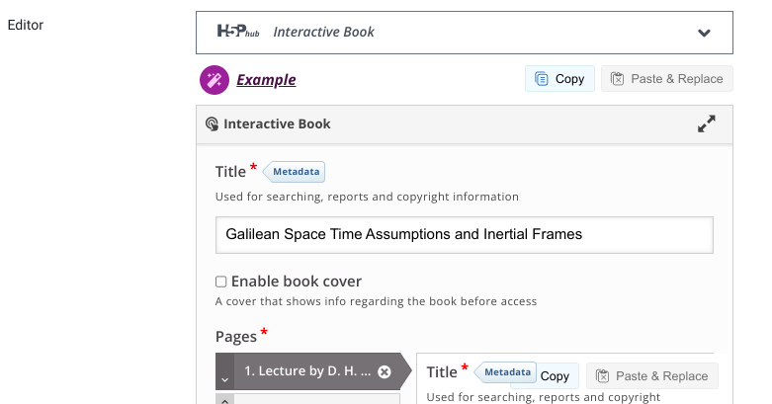
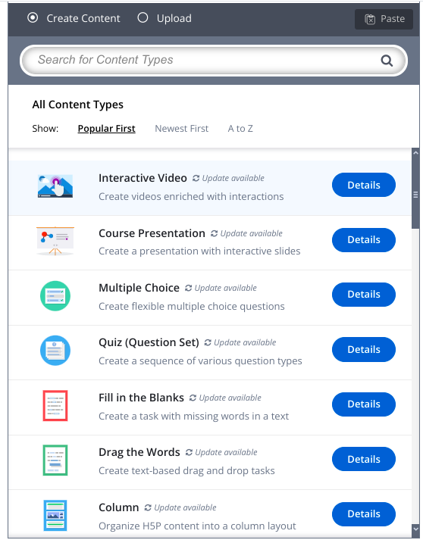

Slide 6
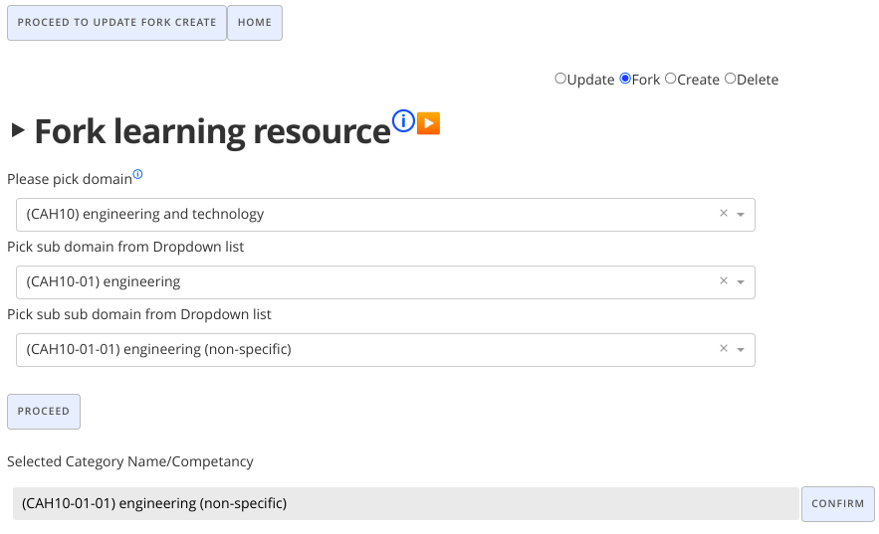

Slide 7
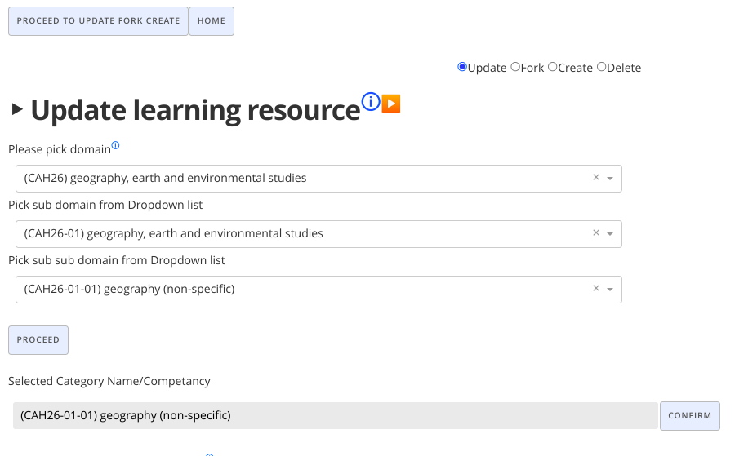

Slide 8
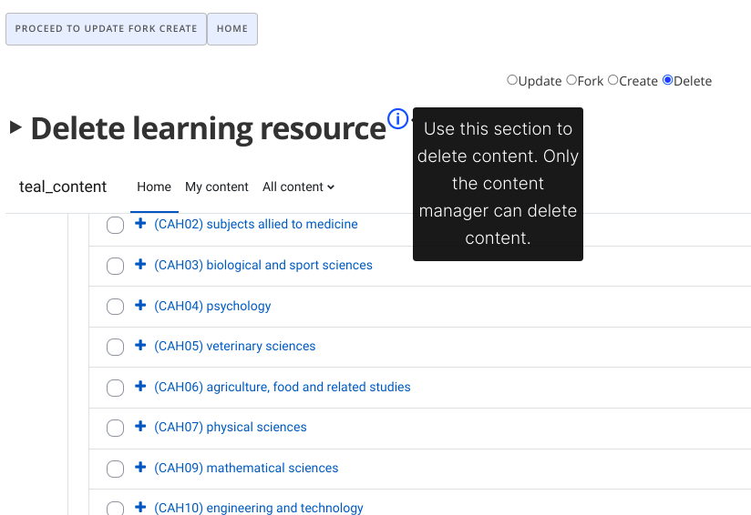

Slide 9
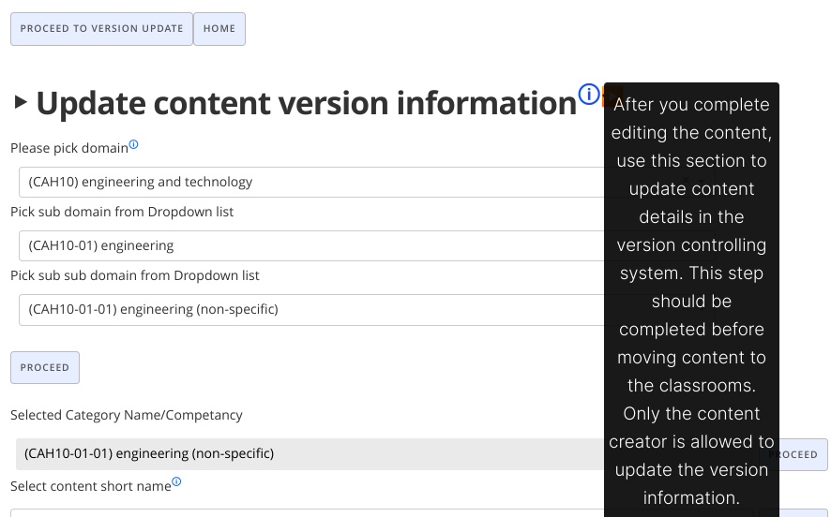

Slide 10
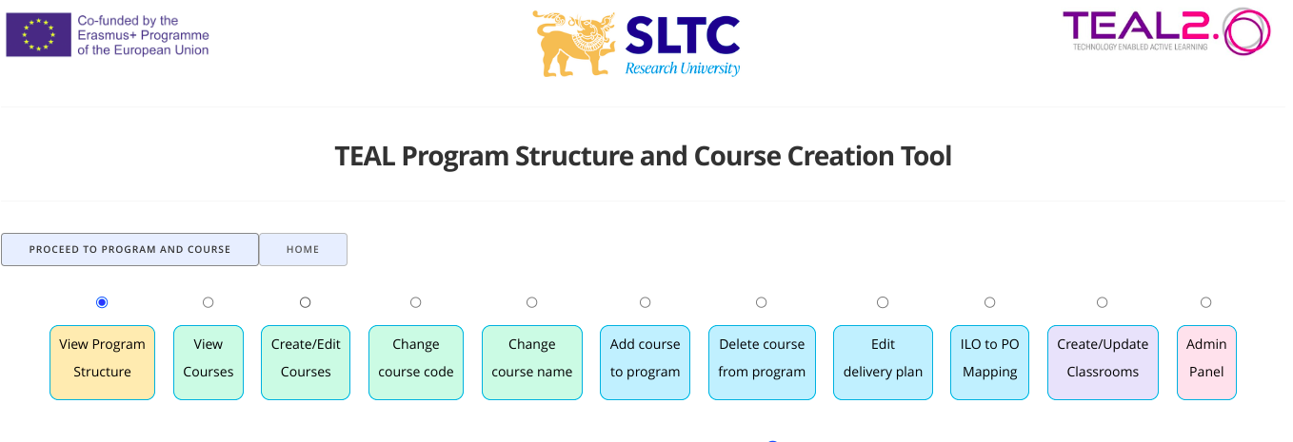
View program
structures.
(For staff/
Students)
Course related options.
(Only course owners can edit)
Program related options.
(Only program leads can edit)
Classroom
creation

Slide 11
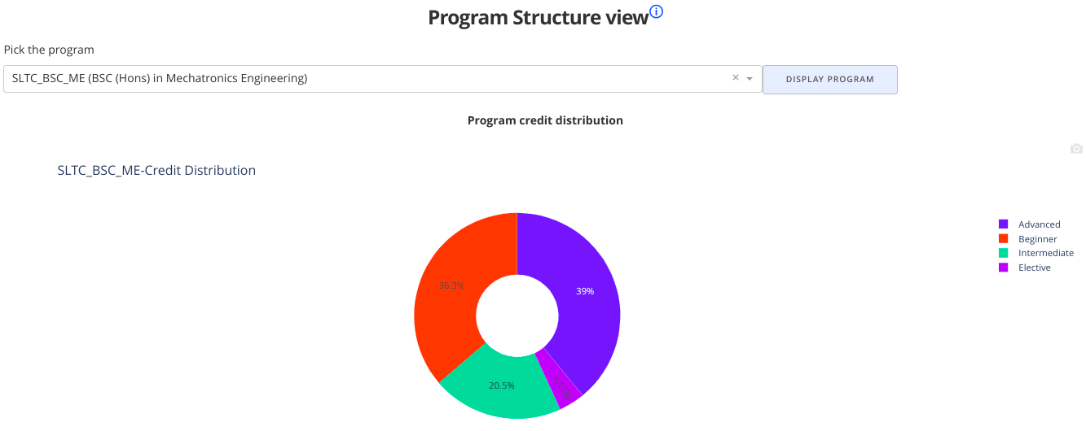

Slide 12
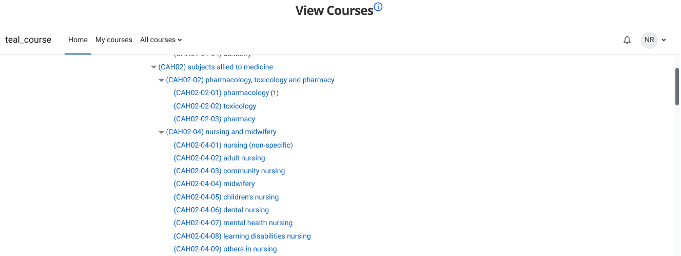

Slide 13
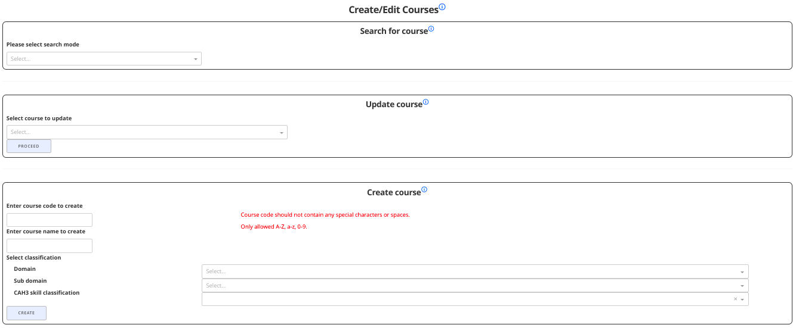

Slide 15
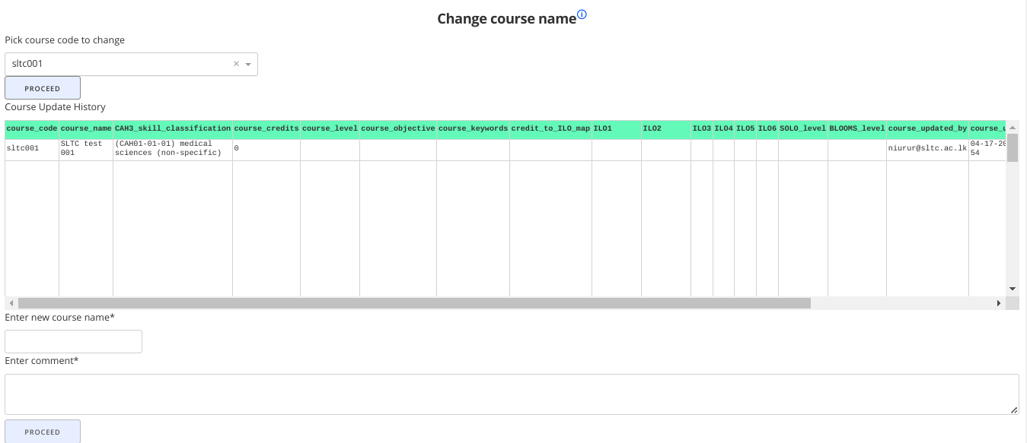

Slide 16
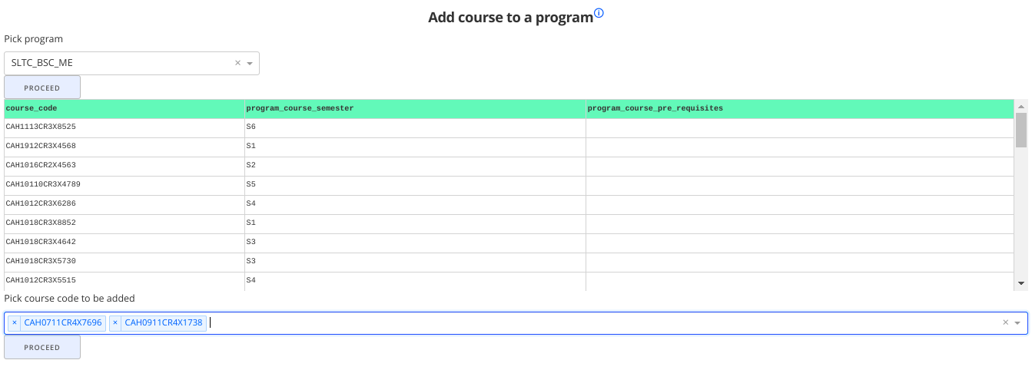

Slide 17
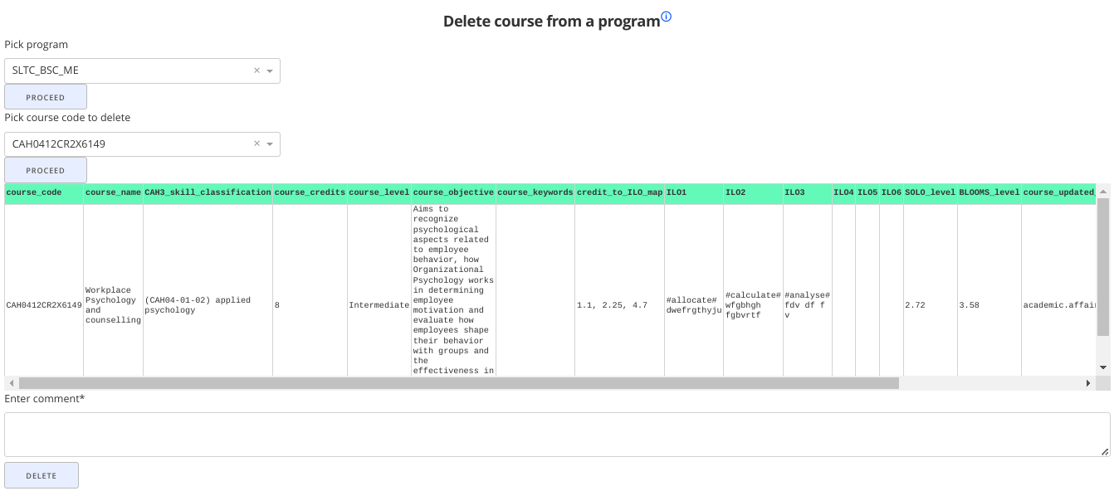

Slide 18
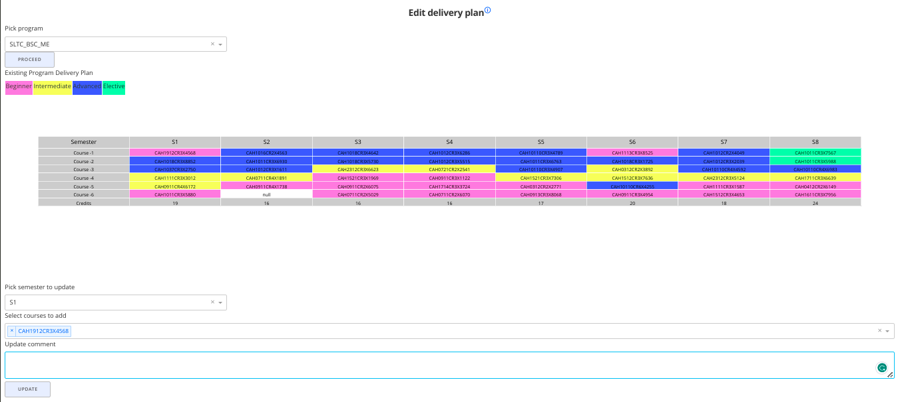

Slide 19
